Slide 1
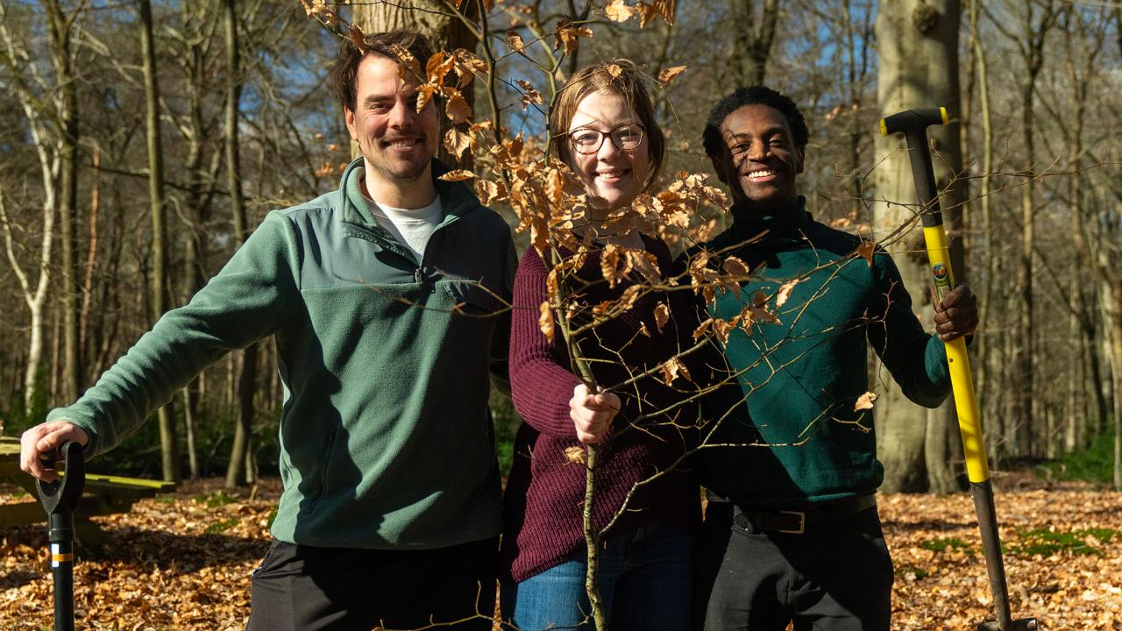


Slide 2

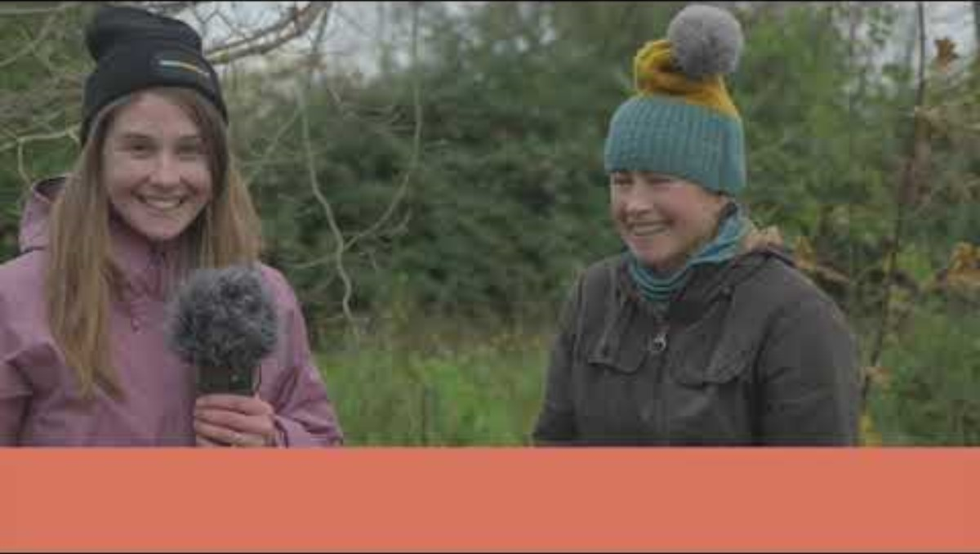


Started in the Netherlands
With 3 foundations
Organisation
IT
Communication
The inventor
Largest tree hub
Ecological knowledge
A progressive farmers organisation for more nature-inclusive agriculture
First UK & Ireland pilot tour: 24/11 - 03/12

Slide 3
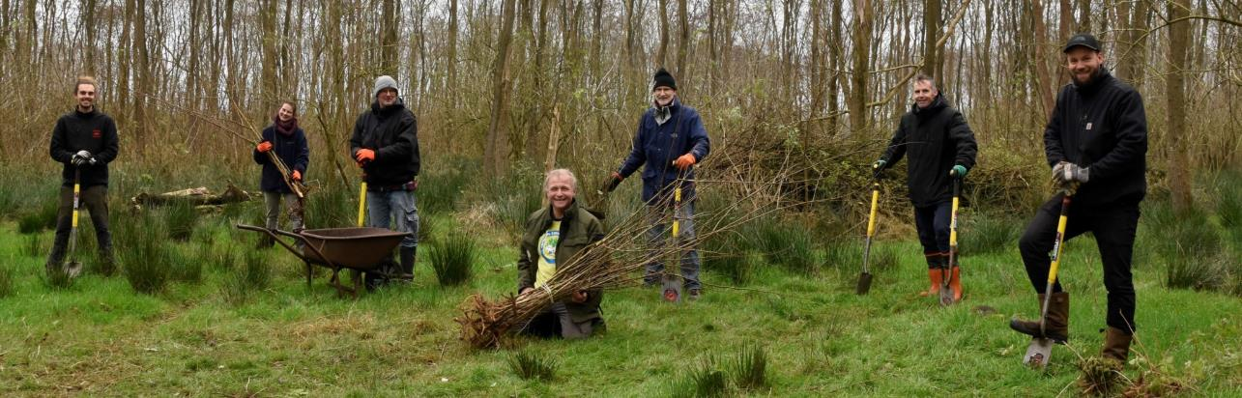




Even voorstellen
The campaign has 3 goals
Stop global warming
Increase biodiversity
Turn climate concerns into climate action

Slide 4
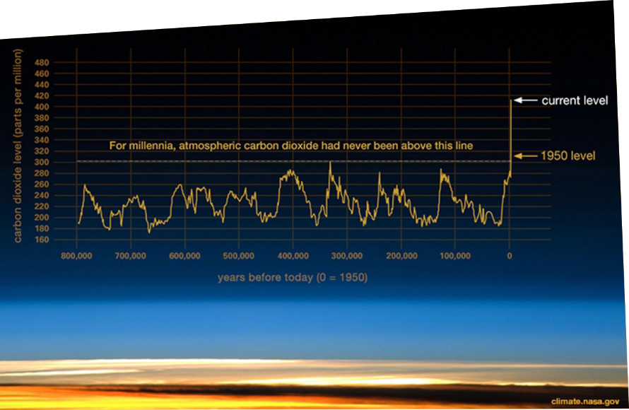
De urgentie is hoog
Before and after the industrial age: 280 PPM CO2 in atmosphere, in 2020: 420 PPM

Slide 5
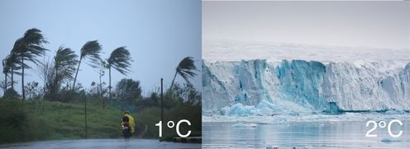
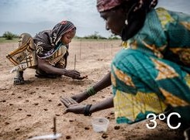
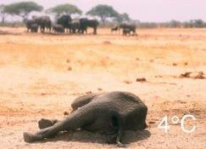
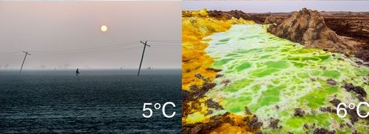
Even 1.5 degrees is too much for many places
At 1.5 degrees, a short review:
  50% of coral reef dies
  Part of north pole ice will stay
  People are still able to live in sub-sahara africa
At 2 degrees, a short review:
  Coral reef will die for 99%
  136 big coastal cities will flood
  Large parts of the world are no longer able to grow basic food grop like corn, rice, and grain
  Over 1.7 billion people will have to deal with stern heatwaves, 420 million will have to deal with extreme heatwaves and over 65 million will have to deal with deadly heatwaves.
  In the summer an ice free north pool, will trigger a tipping point.
Notes:
https://www.zesgraden.nu/

Slide 6
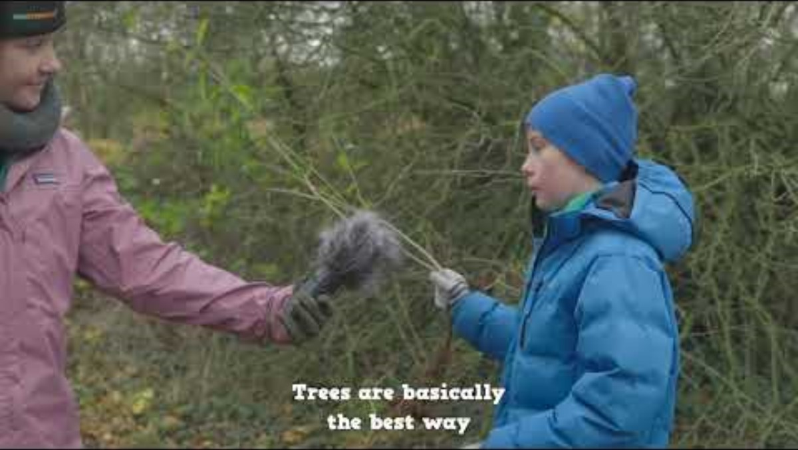
De urgentie is hoog
Climate action
In corby

Slide 7
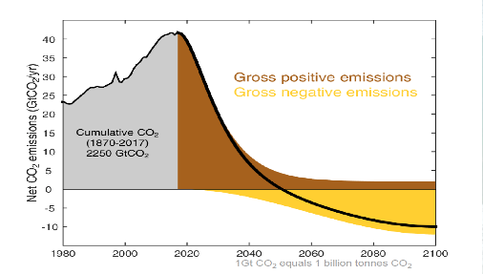
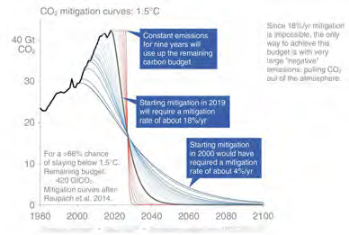
If our emissions do not lower, we will reach 1.5 in 2030, and in 30 years we will reach 2 degrees (KNMI, 2022)
How much do we need to lessen our emissions to remain under 2 degrees?
We need "planetary-scale carbon dioxide removal". In other words; negative emissions, on top of reducing emissions we need to start capturing carbon in trees.

Slide 8
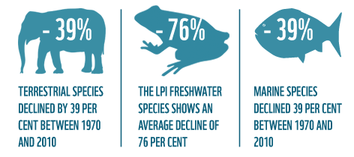
Biodiversity is in strong decline
Due to climate change
Due to pollution
Due to land-use change and subsequent deforesetation
Due to pesticides, herbicides and artifical fertizilers
Due to (illegal) hunting an fishing practices
All species in decline:

Slide 9
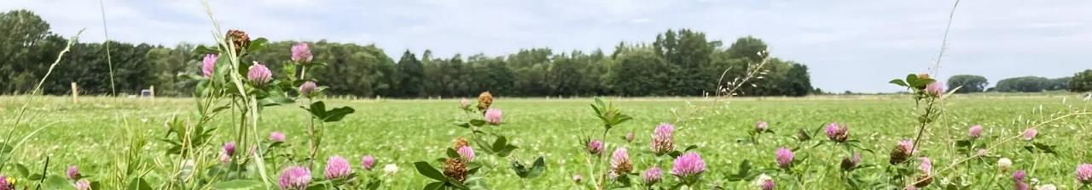
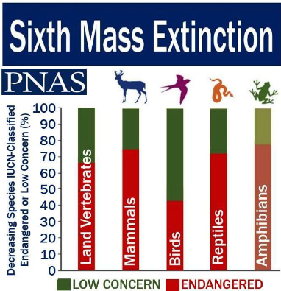
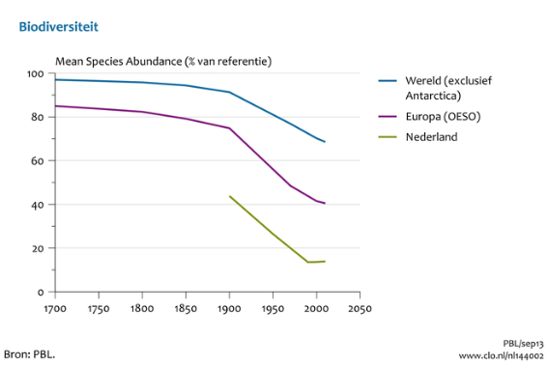
The urgency to restore nature is high

Slide 10
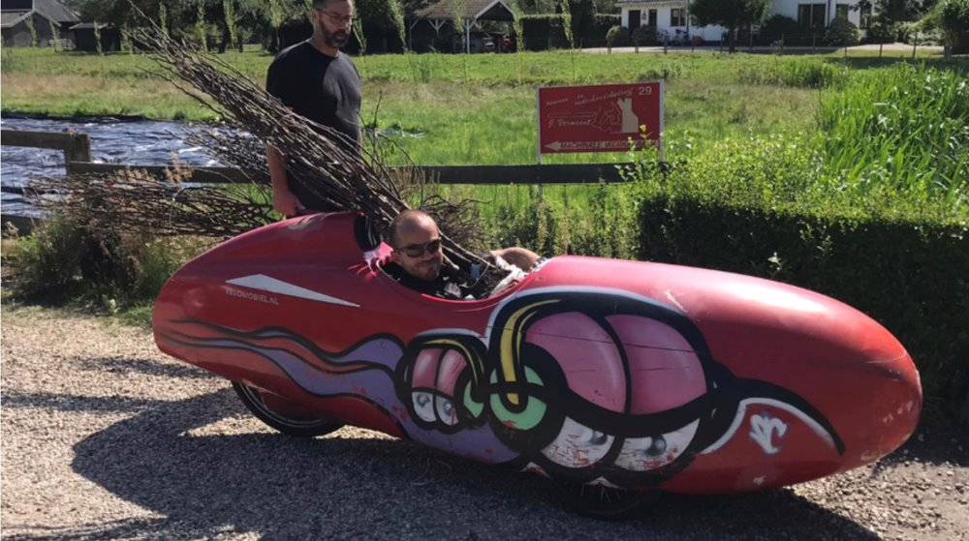




accelerate the solution

Slide 11
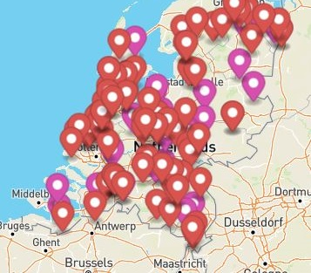
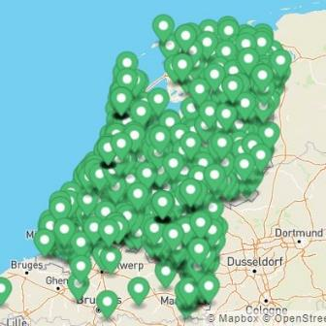
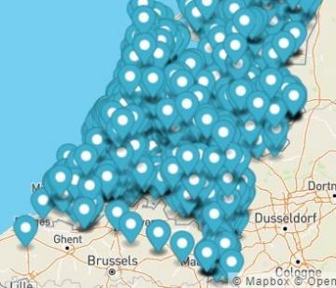

Meer bomen nu (NL)
1.4 million trees in 3 winters
  Saplings
  Cuttings
  Surplus material from growers
Between 70% - 80% of all saplings survived the transplantation
Over 2500+ harvest, distribution and planting events throughout the country
Over 150 volunteer-run hubs throughout the country

Slide 12
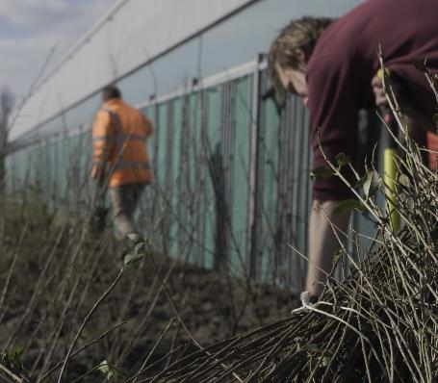
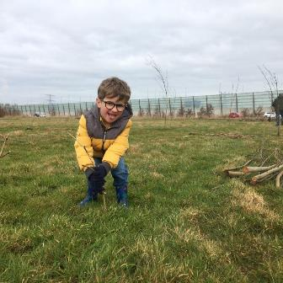
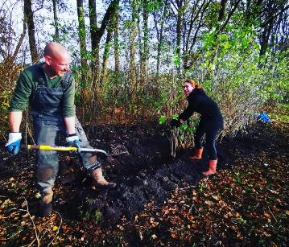
SEASON 1: 2020-2021
500.000 trees in 1 winter
  +/- 250.000 saplings
  +/- 190.000 saved pear trees
  +/- 60.000 saved bushes
Over 80% of saplings survived the transplantation
Volunteer and location management through e-mail and manual dashboard

Slide 13
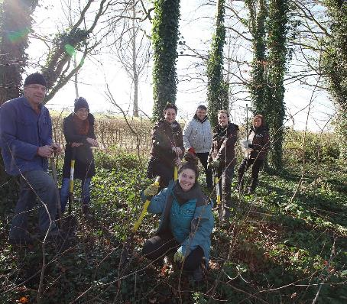
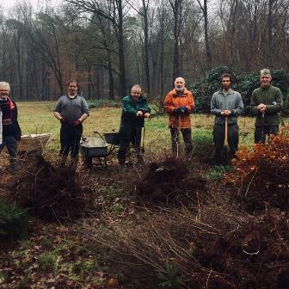
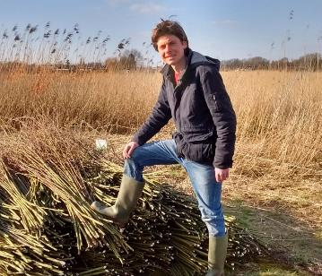
Season 2: 2021-2022
390.000 trees in 1 winter
  +/- 370.000 saplings
  +/- 20.000 saved surplus material
Over 73% of saplings survived the transplantation
Introduction of the treeplanner 1.0
  5000 participants
  Heavily focused on enrolling in events
  Worked with a reservation system

Slide 14
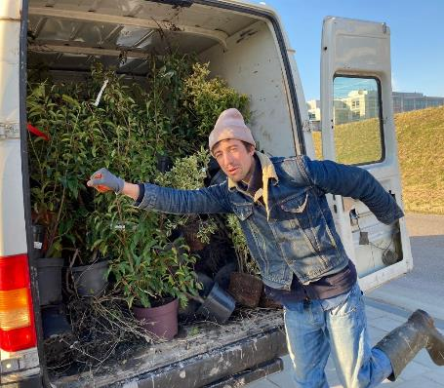
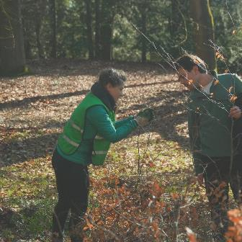
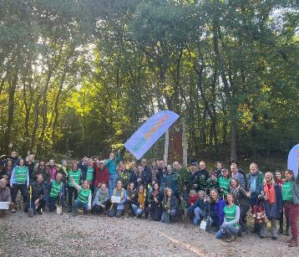
Season 3: 2022-2023
520.000 trees in 1 winter
  520.000 saplings and cuttings
  Over 200.000 growing material saved with pilot Mehr Bäume Jetzt in Germany
Over 70% of saplings survived the transplantation (heatwaves increased)
Introduction of the treeplanner 2.0
  Reached 10.000 participants
  No longer a closed system
  Transactions made more flexible
  Introduction of the treefinder

Slide 15
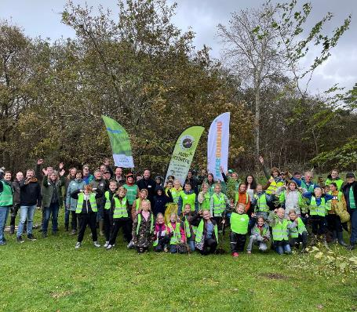
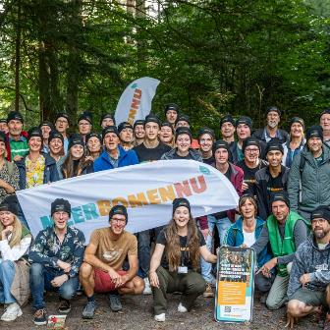
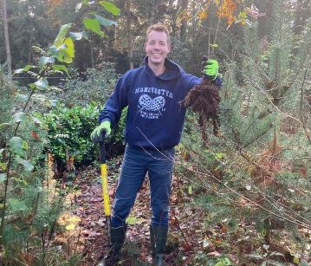
Season 4: 2023-2024
Still ongoing! Just started
  Crossing into 2 million
Introduction of the treeplanner 3.0
  Over 10.000 participants
  Introduction of the app
  User-friendliness upgraded
Mehr Bäume Jetzt started in earnest
Update on ecological knowledge and communication tools
UK & Ireland pilot tour nov/dec 2023

Slide 16
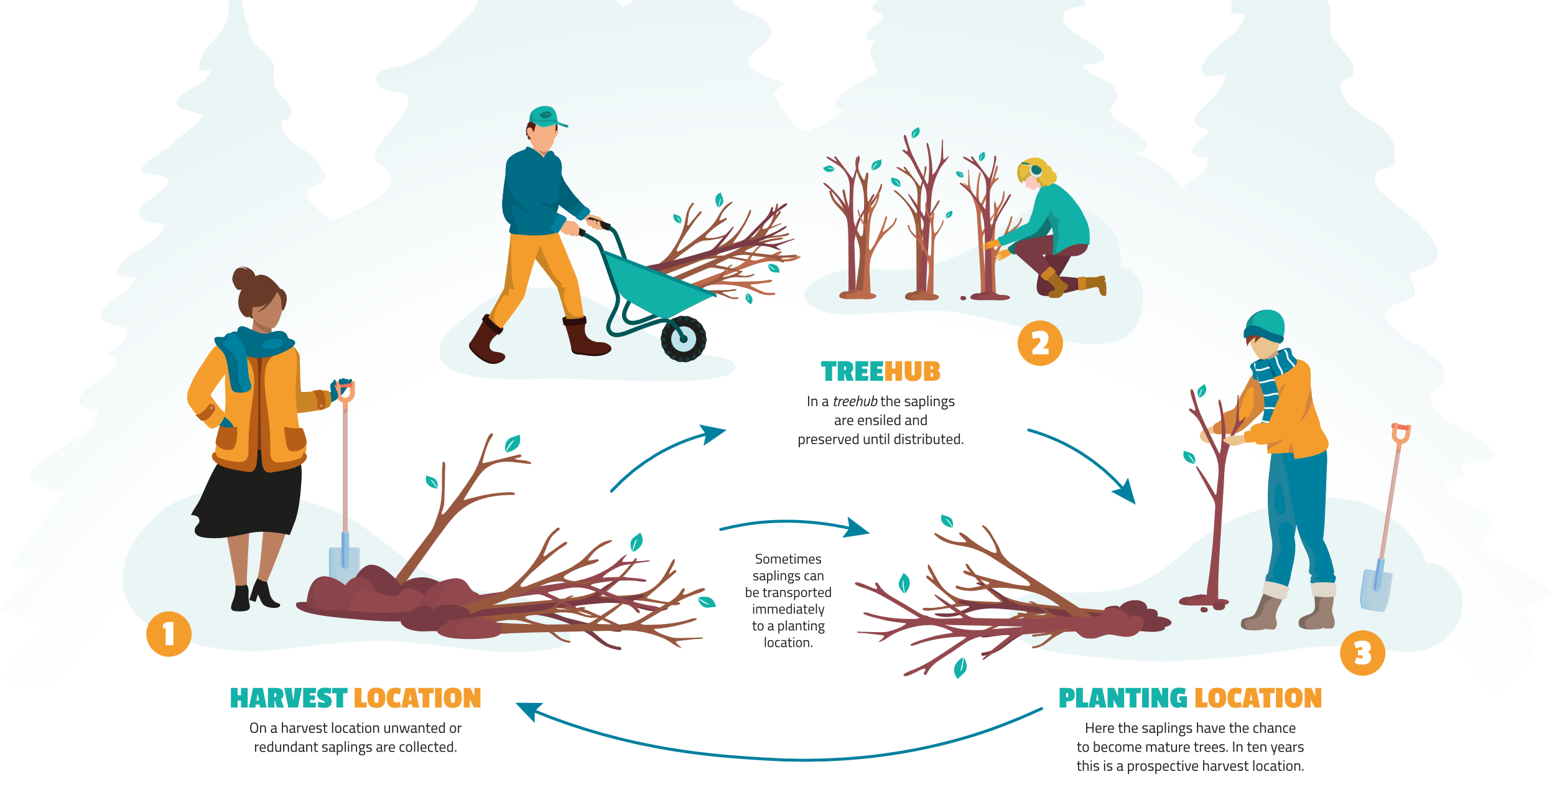

Slide 17






Ecology is the solution
These saplings have already been capturing CO2 for 5-7 years, no extra land, no added materials. Give us time for emission reduction.
Improves biodiversity: both on harvest and planting location!
We move towards a sustainable circular system in our behaviour, supplementing tree-nursery production.
We transform concern into a positive movement that is decentralised and community-led. A day outside improves mental and physical health.
Notes:
Frank's 15 reaons
Manage neclegtec forests
-4? Upgrade rectional and ecological and cultural historical valu e
Free exercise/sporting school
Billions of trees transplanted
Donate for free
Concern to positive energy
Improve biodiversity
Ecological solution to ecological problem
Supplement in sufficient tree nursery production
1 kg wood is 2 kg co2
We gain 10 years with saplings
We gain 50-100 years for energy transition
Unifying concept for man kind

Slide 18
The treeplanner
Connects volunteers and treeplanters to events
Makes registration of trees easy
Gives insight in numbers
Creates embedded data and maps for external use
Informs volunteers about upcoming events
Makes transplanting trees more easy
Has an app!

Slide 19
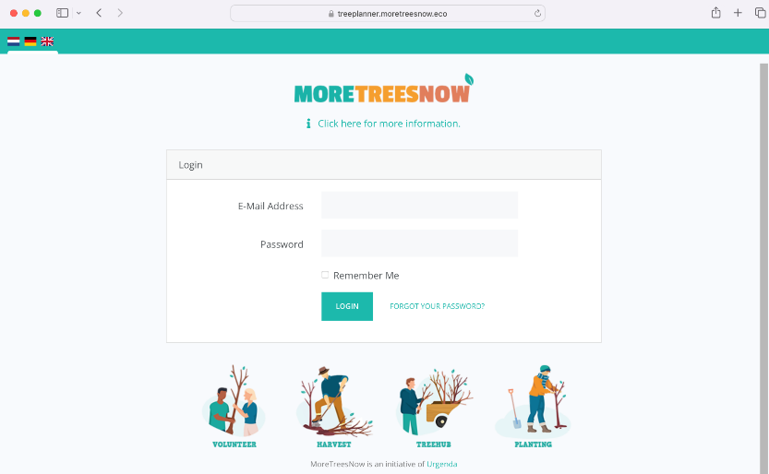
The treeplanner walk through

Slide 20
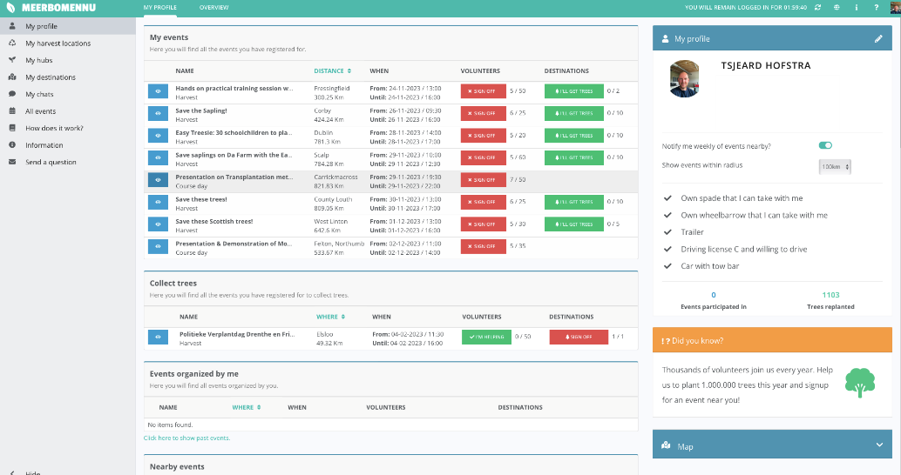
The treeplanner walk through

Slide 21
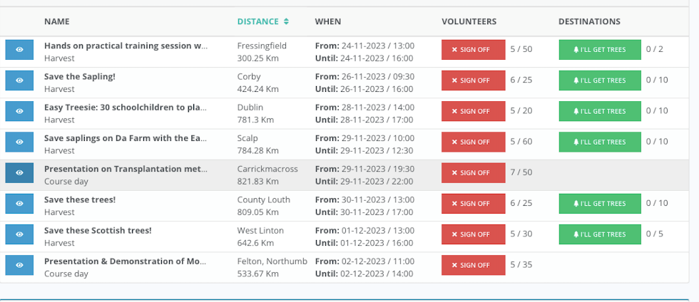
The treeplanner walk through

Slide 22
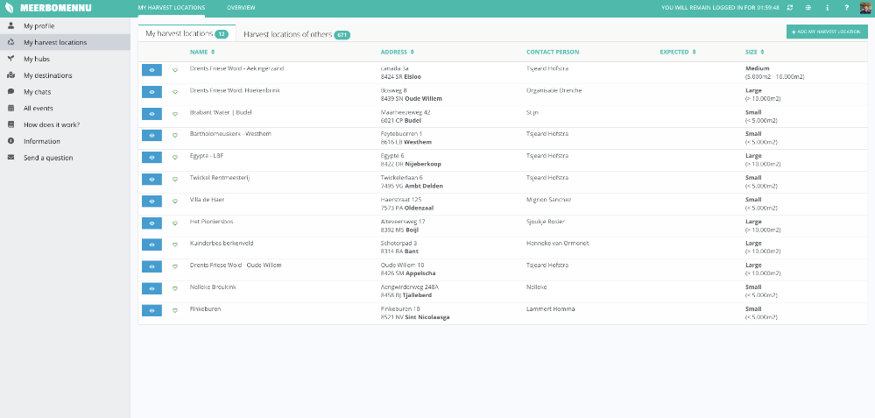
The treeplanner walk through

Slide 23
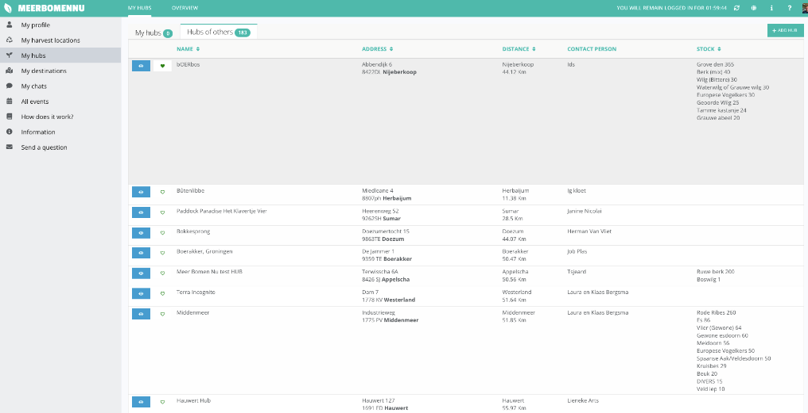
The treeplanner walk through

Slide 24
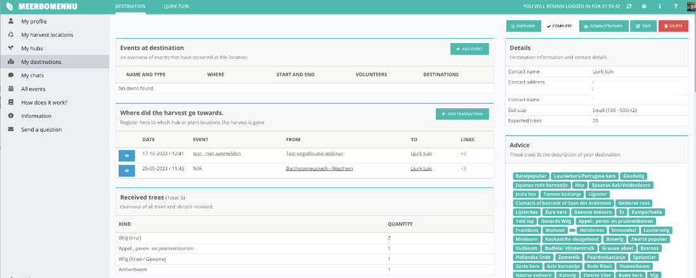
The treeplanner walk through

Slide 25
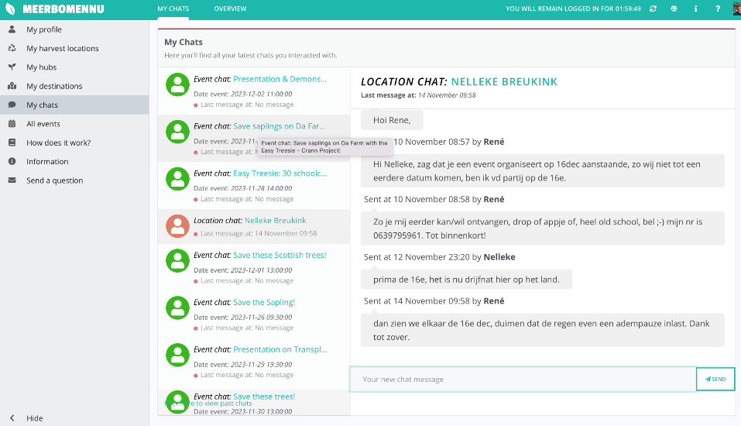
The treeplanner walk through

Slide 26
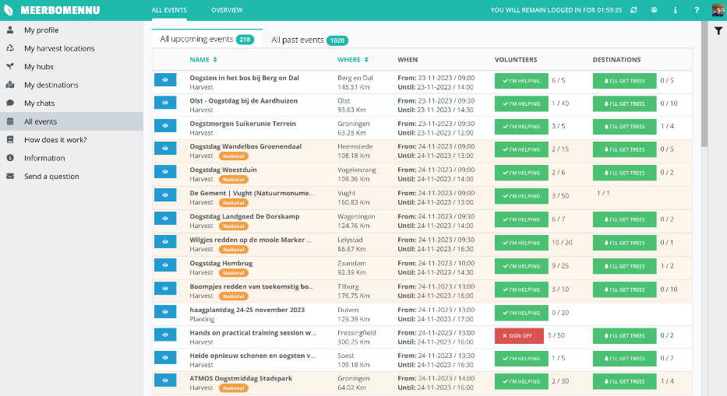
The treeplanner walk through

Slide 27
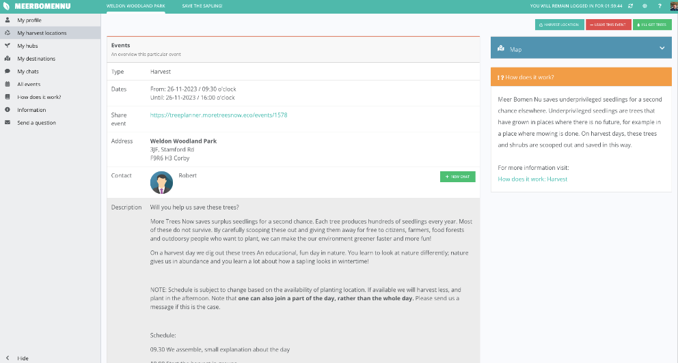
The treeplanner walk through

Slide 28
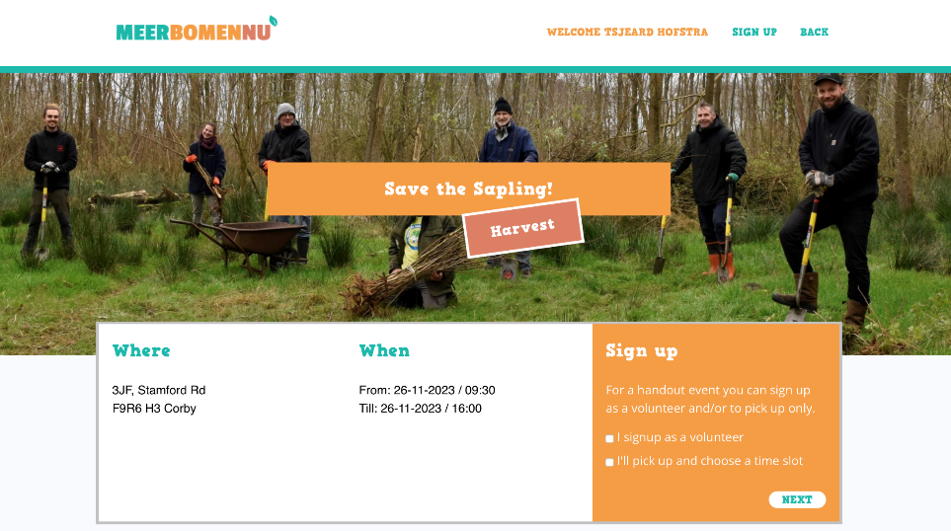

The treeplanner walk through

Slide 29
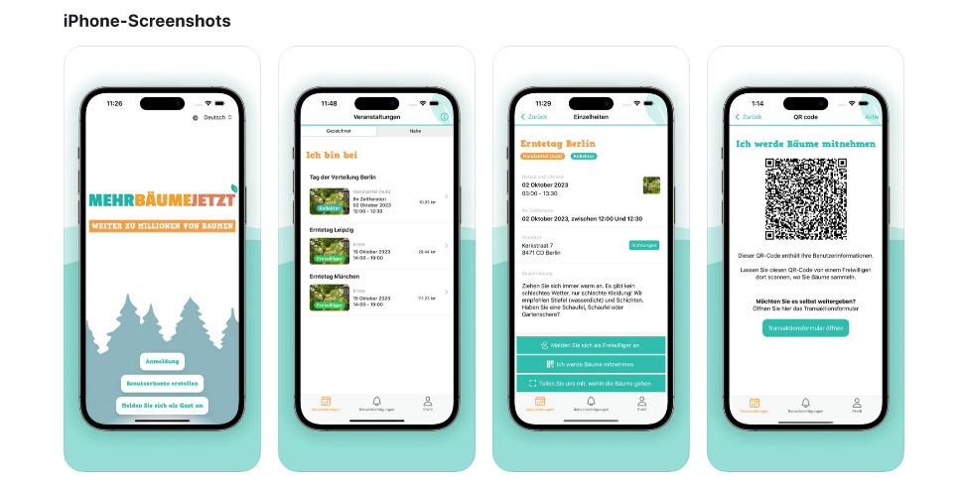
The app

Slide 30
SMALL STEPS, BIG EFFORT
Go to treeplanner.moretreesnow.eco
Click on "volunteer"
Fill in the form and submit
Login on treeplanner.moretreesnow.eco
Now you can:
  Register for free trees
  Register to help
  Add harvest location
  Add tree hub
  Add plant location
  Register collected trees
  Chat with collegues

Slide 32
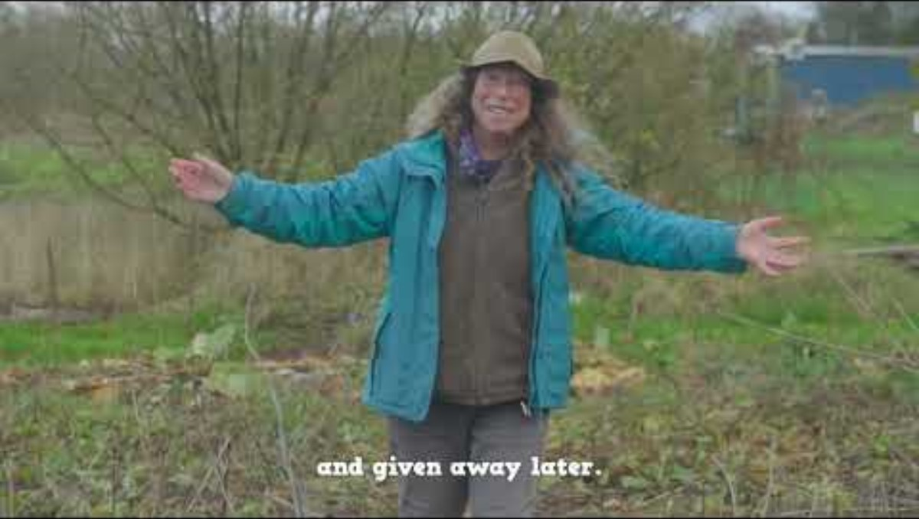

Slide 33
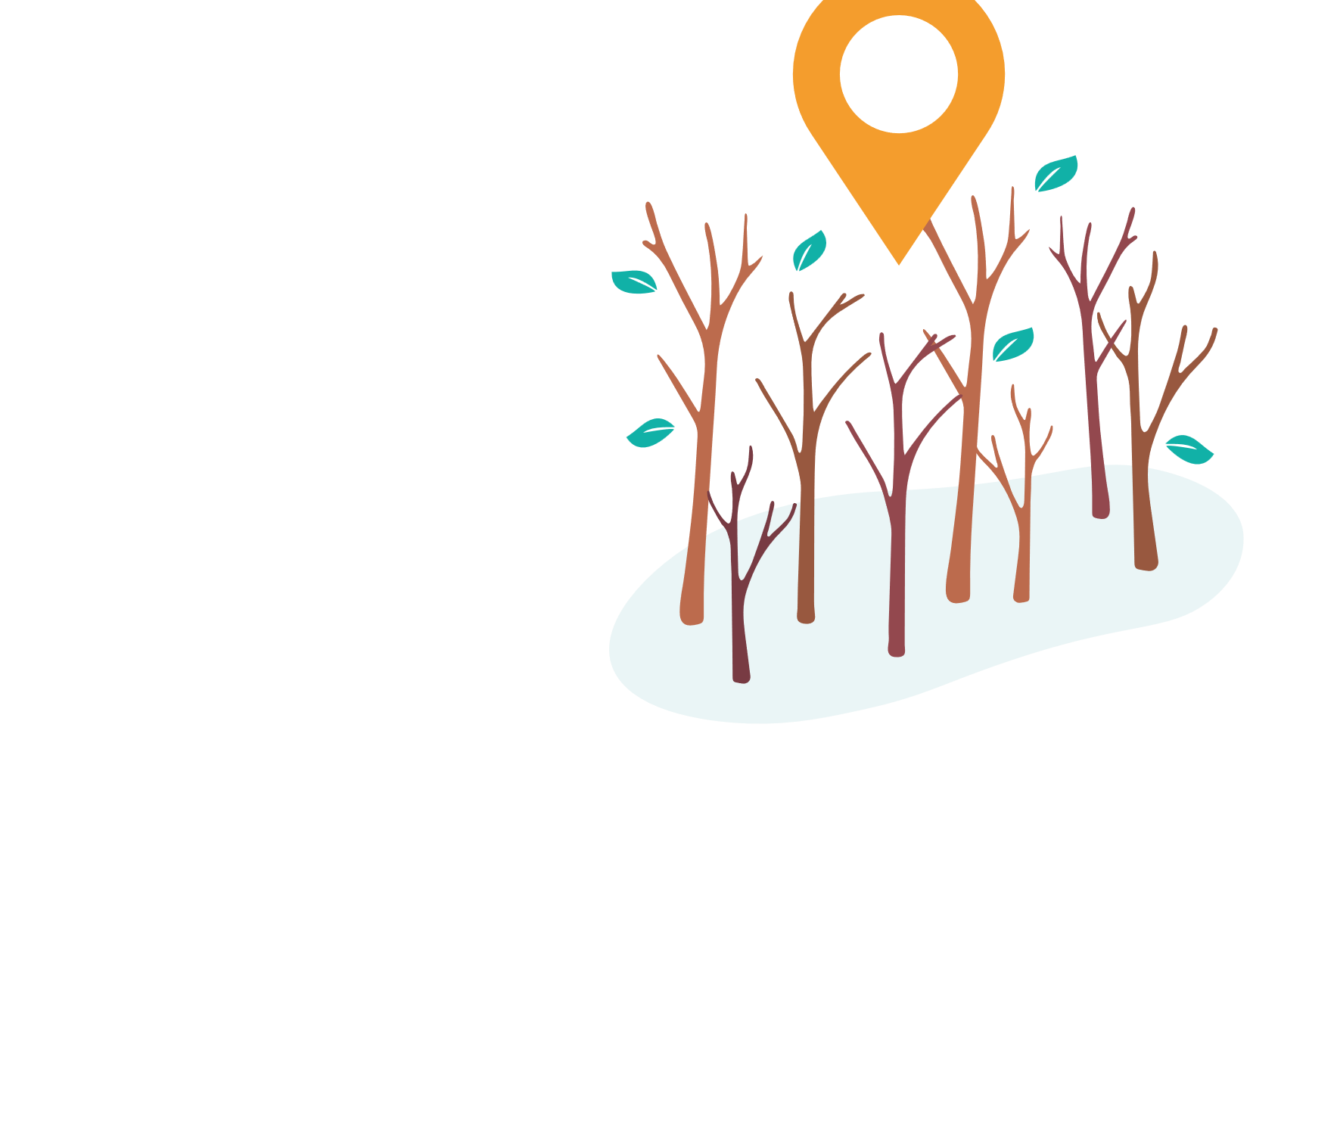
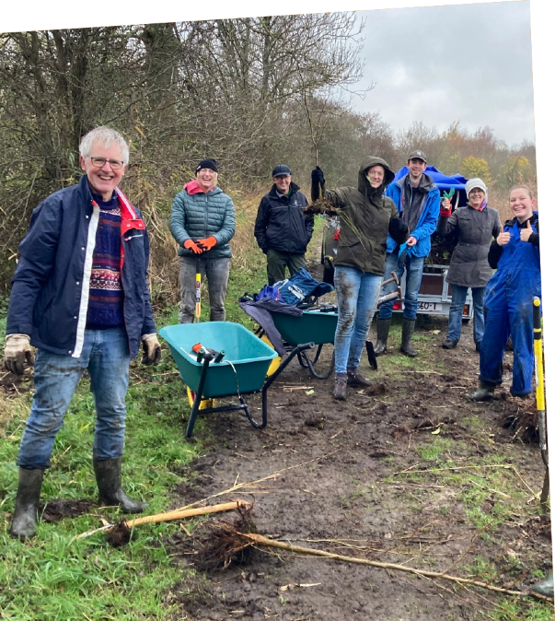
Organise a harvest
Find a harvest-location
Good communication with location manager is key:
  What can be removed?
  What are the species?
  Are there diseases active in the forest?
  What is the best spot for car+trailer (logistics)
Make choices: what harvest area is most interesting
  Wanted species versus bulk species
  coniferous trees versus deciduous trees
Create a location in the treeplanner
Notes:
Natuurgebieden en stadsparken: uitdunnen, opschot, te dicht bij pad, ongewenste soorten
Samenwerking gemeentegroenbeheer, Staatsbosbeheer, Landschappen.
Landgoederen: helpen met achterstallig onderhoud
Achtertuinen: doneer-een-zaailing
Bouwterreinen
Bungalowparken, campings, wegbermen
Knotploegen
Restpartijen van kwekers

Slide 34
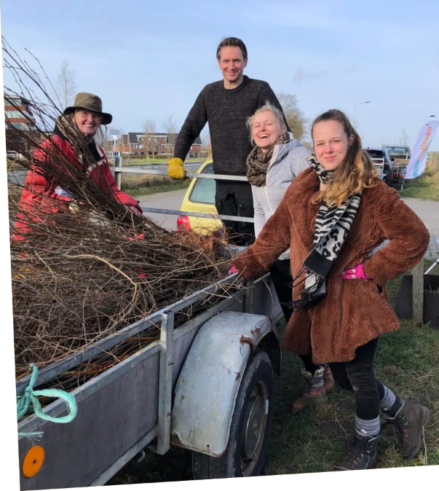
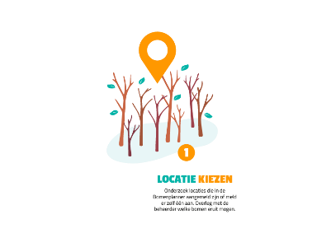
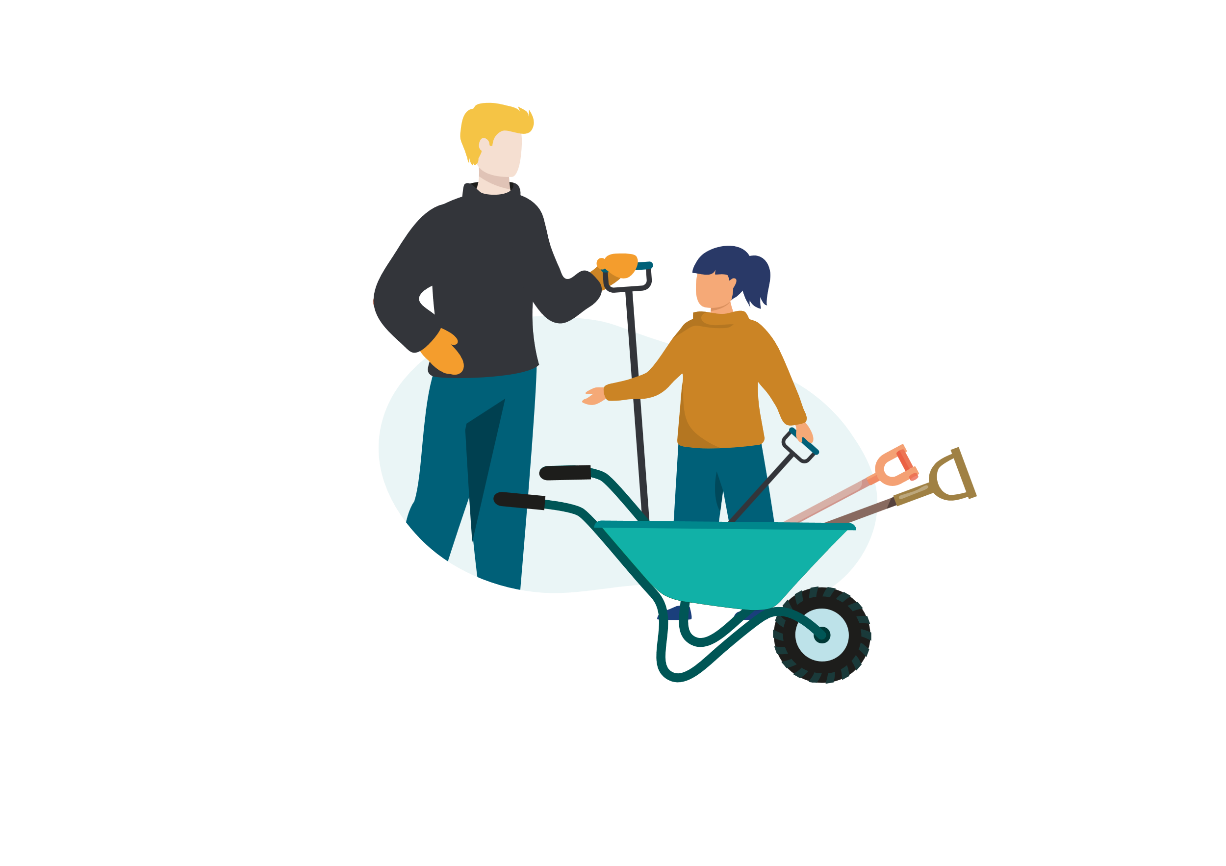
Prepare your event!
Material checklist
Create an event (the sign up link!) in the treeplanner
Promote your event
  A promotion toolkit (will be) available on the www.moretreesnow.eco website
  Images, text, flyers, posters, etc.
Notes:
Natuurgebieden en stadsparken: uitdunnen, opschot, te dicht bij pad, ongewenste soorten
Samenwerking gemeentegroenbeheer, Staatsbosbeheer, Landschappen.
Landgoederen: helpen met achterstallig onderhoud
Achtertuinen: doneer-een-zaailing
Bouwterreinen
Bungalowparken, campings, wegbermen
Knotploegen
Restpartijen van kwekers

Slide 35
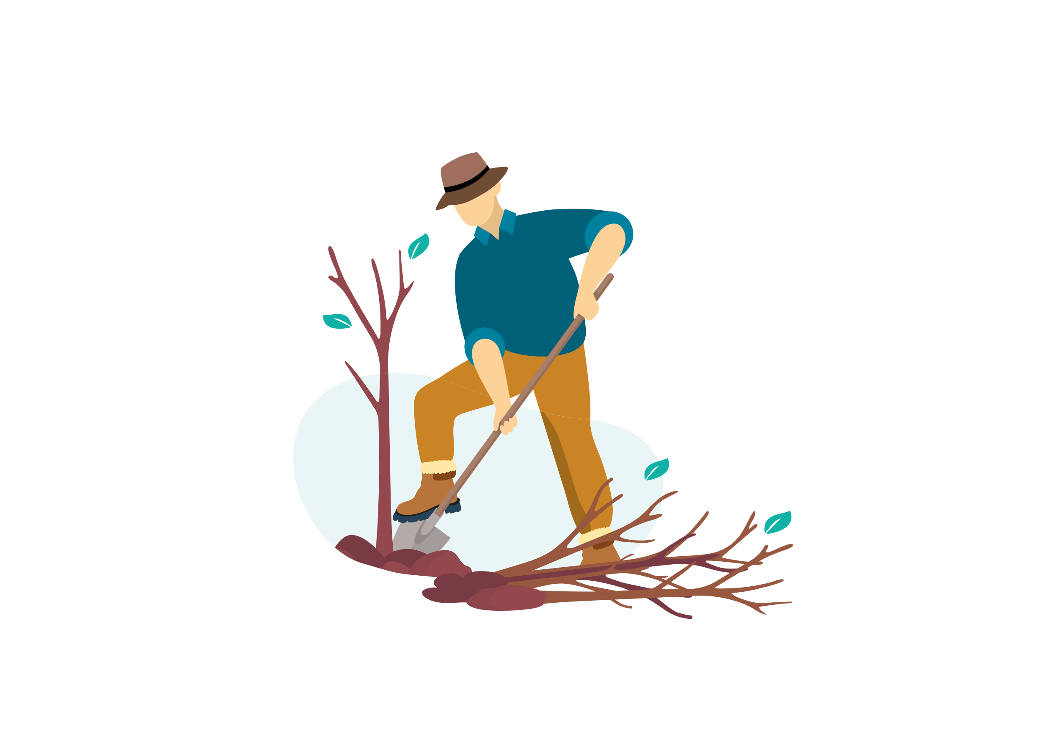

the harvest day
Education: learn about trees
A fun day outside
Between 300 to 6000 trees saved every day!
Always (!) in accordance with location manager
Always have an organiser/harvest leader
Leave the place as clean and beautiful as you found it
Volunteers need only a shovel and enthusiasm to join!
Notes:
Natuurgebieden en stadsparken: uitdunnen, opschot, te dicht bij pad, ongewenste soorten
Samenwerking gemeentegroenbeheer, Staatsbosbeheer, Landschappen.
Landgoederen: helpen met achterstallig onderhoud
Achtertuinen: doneer-een-zaailing
Bouwterreinen
Bungalowparken, campings, wegbermen
Knotploegen
Restpartijen van kwekers

Slide 36


sort the sapling
Sort per species
  Use the buds-card!
  Check the decision tree for native/exotic trees
  Check the health of the sapling
  "treefinder" - who can help us create it?
Bundle per species
  Per 20 or 50
  Make sure alle the roots are on the same level
Register per species
  Per origin -> per destination
  Write it down and then put it in the treeplanner
  Do it immediately with the app!
Notes:
Natuurgebieden en stadsparken: uitdunnen, opschot, te dicht bij pad, ongewenste soorten
Samenwerking gemeentegroenbeheer, Staatsbosbeheer, Landschappen.
Landgoederen: helpen met achterstallig onderhoud
Achtertuinen: doneer-een-zaailing
Bouwterreinen
Bungalowparken, campings, wegbermen
Knotploegen
Restpartijen van kwekers

Slide 37


Safe sapling transport
Picked up directly by a final destination
  With enough participants in the treeplanner people can sign up on your event, but you can also call them.
Coordinate with the tree-hub
  Help heeling in the saplings
Mini-give-away at the end of your harvest day
Other options: temporarily heel them at your harvest location
Protip
always cover the roots during your harvest day and during transport to prevent them from drying out

Slide 38

Treehubs for beginners
What is a good location?
How much space to you need?
How many people do you need to run a treehub
What materials do you need to run a treehub?
Sign up as a treehub and find your people!

Slide 39
What does a treehub do?

Slide 40

What does a treehub do?

Slide 41


Collect the trees
Keep good communication with the harvest team
Check the saplings
Protect them from sun and wind during the trip
Heeling in
Heeling in the saplings
Heeling in the cuttings
Make sure to have volunteers

Slide 42


sort, bundle, register

Slide 43

Register what's in the hub!
You always register per species, you fill in the origin ánd the destination
The treeplanner
The app
Learning about trees:
Sorting: use the map with tree-buds
"treefinder"
Native versus exotic

Slide 44

Distribute: organise a give-away
Create a give-away event in the treeplanner
Creates timeslots: put in you maximum!
Volunteers: same sign up sheet, different list
Create breaks by 'locking' time slots
Registration made super easy by QR codes generated by the treeplanner!

Slide 45


Slide 46
Optimal lay out of you treehub for a give-away
Make a clear entrance and exit
Take our the first of every few species to be distributed and protect the roots with sail or jute bags
Create tree & registration area's
Make sure your volunteers are recognisable

Slide 47








Promote you give-away!
In Holland we've created a communication toolkit, which we hope to translate to the UK and Irish context.
Brochures
Diverse templates voor social posts
Flyers

Slide 48

Planting our trees
Farms, food forests, private citizens
No demanding contracts
We give advice on the website
Always give a mix (no monoculture!)
Helpers get the best trees
Planting location can create their own events for help
We plant with companies, schools and more.

Slide 49

Bring back what has been lost (NL)

Slide 50

Join us!
Form a harvest team
Guide harvest days
Run a treehub
Write to your local council
Drive trees around
Mobilise volunteers
Provide support to the community (social media, mail)
Create a community
…. there is an opportunity for anyone to join in!

Slide 51

Let’s build a community

Slide 52

Questions?
Email us on info@moretreesnow.eco

